Slide 1
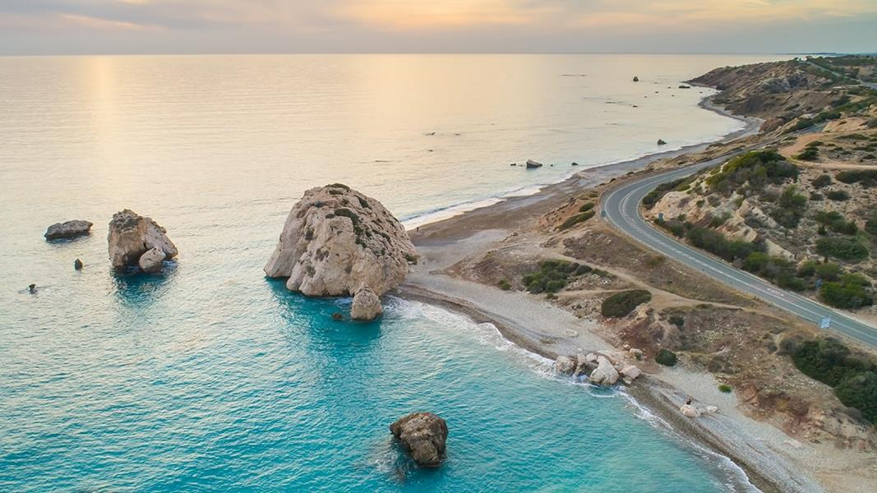
LUXURY BEACH GETAWAY IN PAPHOS
StUDENTS:
AnTONESCU IULIA
APOSTOL mARIO
CIOCARILAN sTEFAN
TUDORAN ANDREI

Slide 2
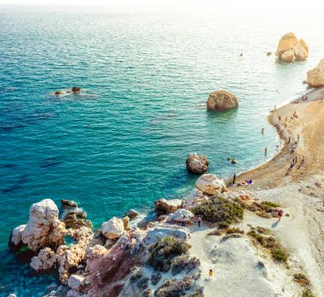
Introduction
Good [morning/afternoon], and thank you for considering us to plan your dream luxury beach getaway in Paphos, Cyprus. Over the next few minutes, I will take you through an exclusive, tailored 8-day itinerary that combines relaxation, culture, adventure, and luxury – all within your €6,000 budget. This escape is designed for a couple seeking the perfect mix of relaxation, fine dining, indulgent treatments, yacht tours, and exploration of Cyprus’s rich cultural heritage.

Slide 3
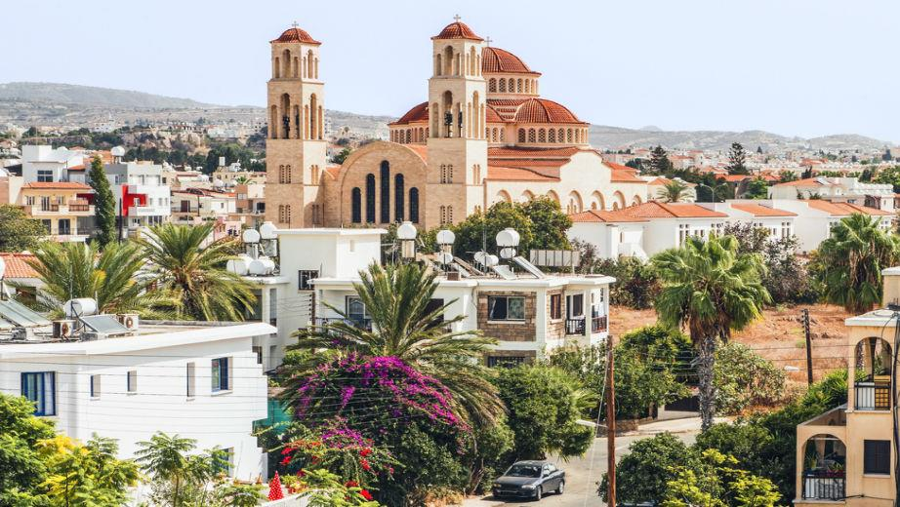
Paphos trip
Date: 2 July – 9 July 2025
Period of staying: 8 days/ 7 nights
Airplane from London airport(STN) to Paphos at : 7:00 am – 13:20 pm
Airplane from Paphos airport to London(STN) at : 15:50 pm – 18:30 pm

Slide 4
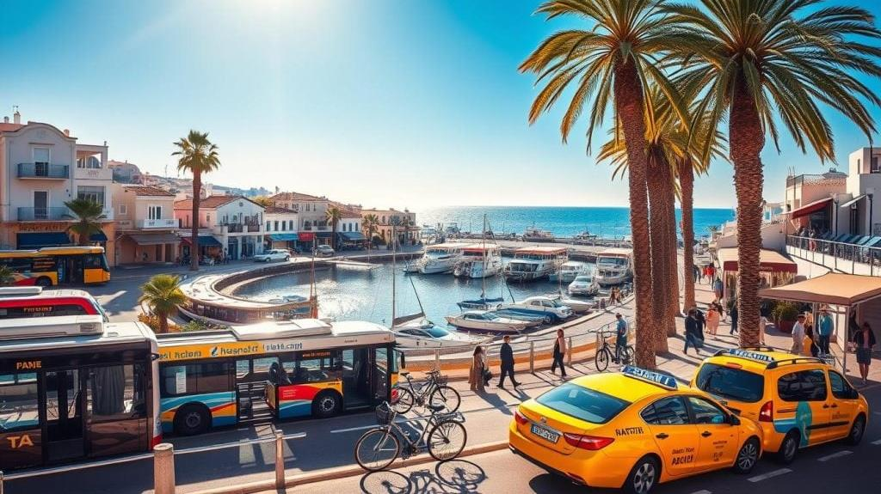
Transportation in Paphos
We can help you rent a car for the period of the trip
You can also travel by buses , taxi or bus tour with other people
You can also rent from you're hotel bicycles and electric scouters

Slide 5
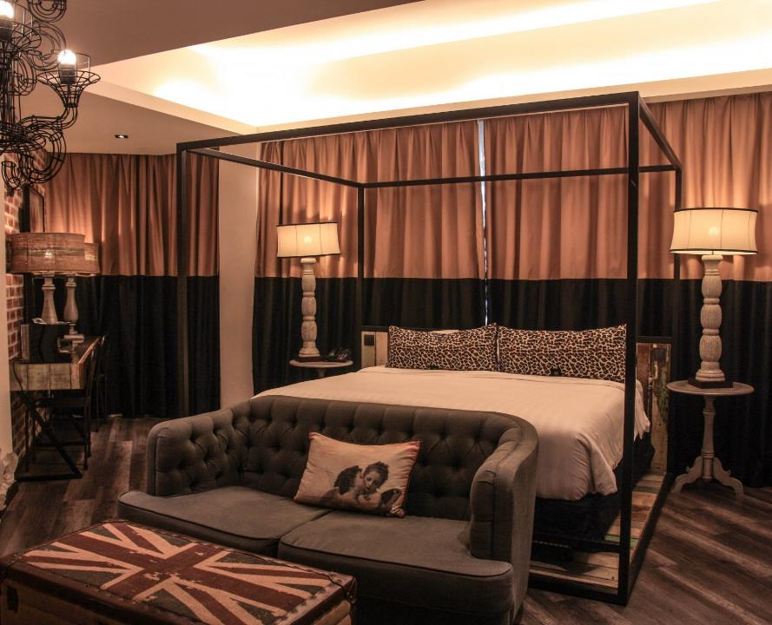
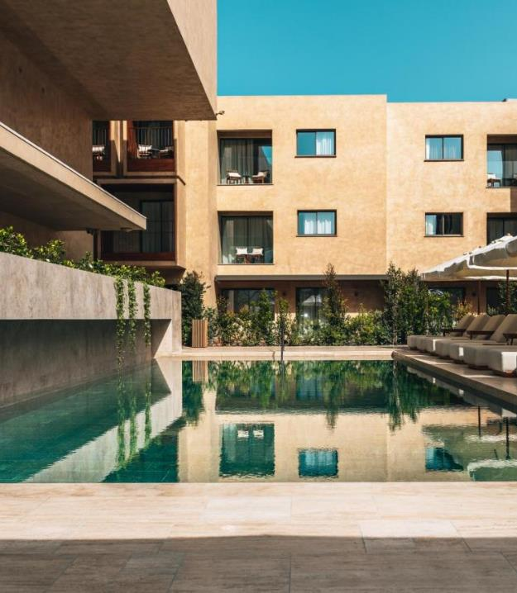
ACCOMMODATION 1
M Boutique Hotel
Why M Boutique Hotel?
2-minute walk from Paphos Municipal Baths
spa and wellness center
outdoor pool
luxurious restaurant
suitable for couples(They rated it 9.5 for a stay for 2 people)

Slide 6
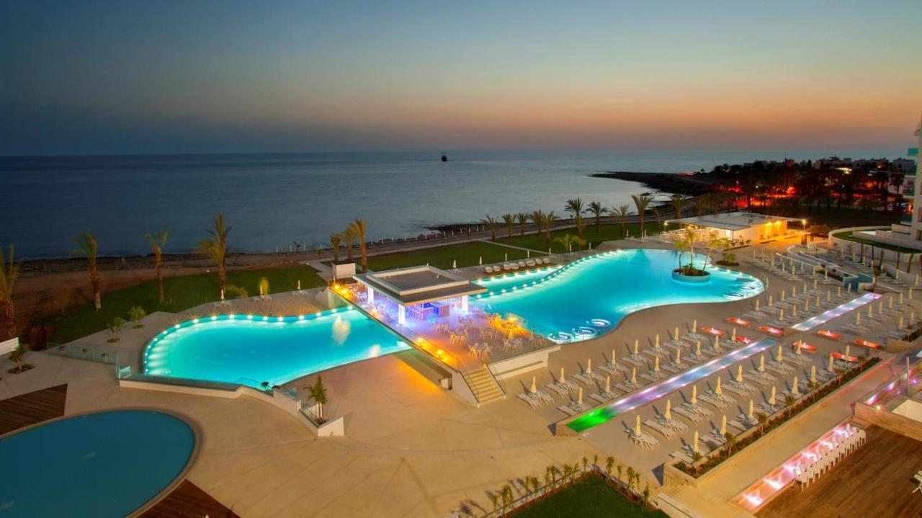
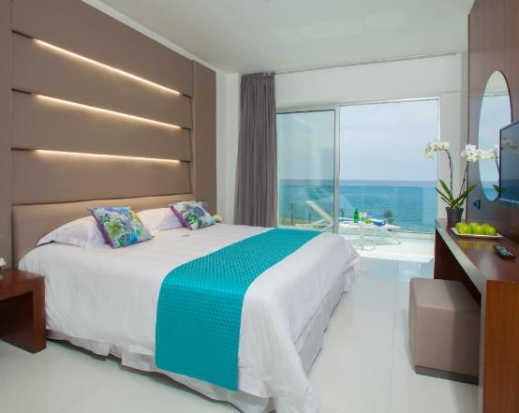
ACCOMMODATION 2 King Evelthon Beach Hotel & Resort
Why King Evelthon Beach Hotel & Resort?
-Offering an outdoor and indoor pool.
-Selection of restaurants and bars.
-Spa treatments and therapies.
-Waterpark facilities are included.
-4 restaurants
-Fitness room
-Immediate access to the beach

Slide 7
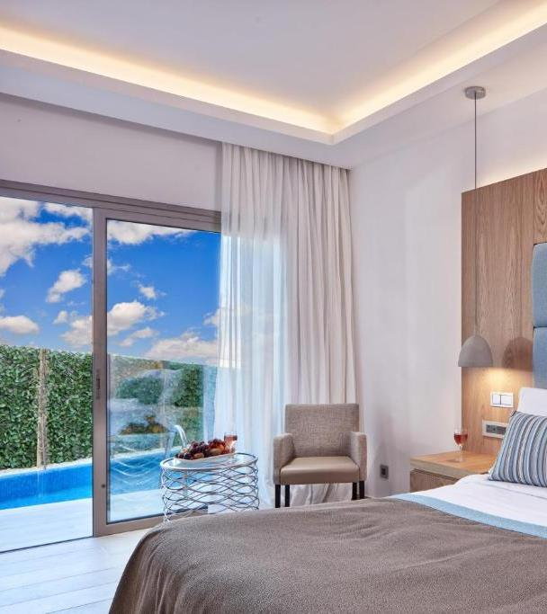
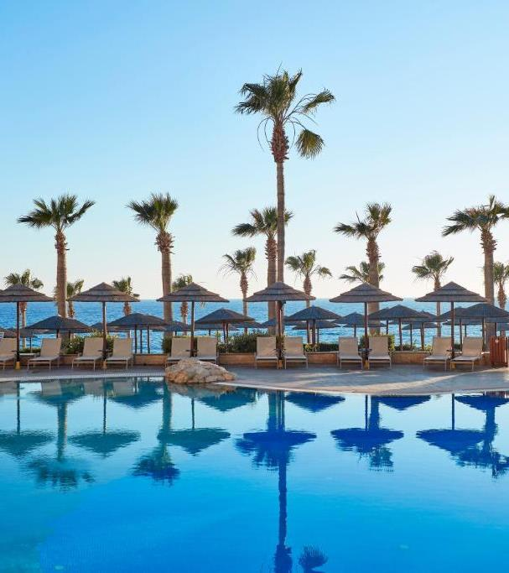
ACCOMMODATION 3
Atlantica Golden Beach Hotel
Why Atlantica Golden Beach Hotel?
Offers mediterranean and basilico restaurants with fine dining dishes
special diet menus (on request)
Private beach zone
Immediate access to the beach
Spa and wellness centre
Open bar

Slide 8
PLACES TO VISIT
Tomb of the Kings-The tombs are carved into the rock, and have many impressive architecture with large courtyards, columns, and elaborate burial chambers. It’s one of the most significant archaeological sites in Paphos.
Paphos Arheological Park-Paphos Archaeological Park is a sprawling site encompassing many important ancient ruins in Paphos. It includes the Tomb of the Kings, the ruins of ancient Paphos (Nea Paphos), and the House of Dionysos with its beautiful mosaics
Aphrodite Rock -Aphrodite's Rock, located just outside of Paphos, is a stunning coastal landmark that is traditionally thought to be the birthplace of Aphrodite, the Greek goddess of love and beauty
Catacombs-The Catacombs of St. Solomon, located near the Tomb of the Kings, are an ancient site with Christian and Pagan significance. These catacombs were used as burial sites and are carved into the rock. The site is named after St. Solomon, a Christian martyr, and the tombs inside are believed to date back to the early Christian period
The Paphos Castle-Paphos Castle, located at the harbor, is a medieval Byzantine fort that was originally built in the 13th century to protect the harbor from invaders. It was later rebuilt by the Lusignans and further modified during the Ottoman period
Paphos port-Paphos Port is a scenic and lively area of the city. The harbor is a hub for tourists, with a variety of restaurants, cafes, and shops lining the waterfront. It’s a great place to take a leisurely stroll or enjoy a meal with a view of the sea and the boats coming and going

Slide 9
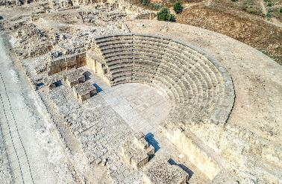
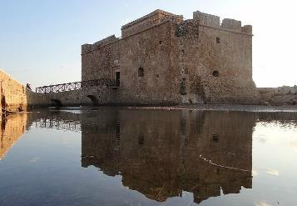
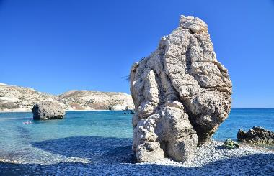
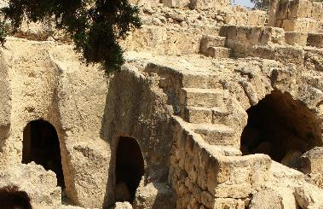
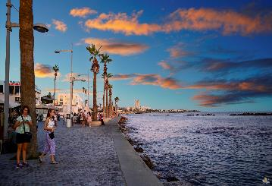
Tombs of the Kings
Paphos Arheological Park
Paphos Castle
Aphrodite Rock
Catacombs of St. Solomon
Paphos port

Slide 10
ACTIVITIES TO DO
Cyprus Wine and Vineyards Wine Tasting Tours: Paphos is in the heart of Cyprus’ wine region. You can visit local wineries and take part in wine-tasting tours to sample some of the island's best wines.
Omodos Village: A charming village in the Troodos Mountains known for its wine production and traditional Cypriot architecture.
Paphos Zoo: A great option for families, the Paphos Zoo is home to a variety of animals, including birds, mammals, and reptiles. It’s a nice way to spend a few hours.
Dining and Nightlife Enjoy Cypriot Cuisine: Try local dishes like meze (a collection of small dishes), souvlaki, kleftiko, and halloumi cheese. You can find many seaside tavernas and cafes.
Bar Street: For nightlife, head to Bar Street in the heart of Paphos for a variety of bars and clubs offering drinks and music.
Hiking and Outdoor Activities Troodos Mountains: If you enjoy hiking, head up to the Troodos Mountains, which are only a short drive from Paphos. The area offers scenic trails and views of the island's natural beauty.
Cycling: Rent a bike and explore the scenic routes around the city or along the coast.
Boat trips: Paphos offers a variety of boat trips that let you explore its stunning coastline, crystal-clear waters, and historical landmarks.

Slide 11
OTHER ACTIVITIES
FINE DINING RESTAURANTS
NIGHT LIFE
La Cultura de Gusto embodies a rich and diverse culinary culture that transcends borders. They have mastered the art of creating a symphony of flavors that draw inspiration from Mediterranean and Asian cuisines. Each dish on their menu tells a unique story.
The O'Shin pan-Asian Sushi is a popular restaurant for eating the ultimate Asian cuisine in Paphos within elegant oriental-styled surroundings
Amaracus Restaurant
Flairs Cocktail bar
Boggies Karaoke bar
Rainbow club
Loft club
Wave Dancer Fireworks night cruise

Slide 12
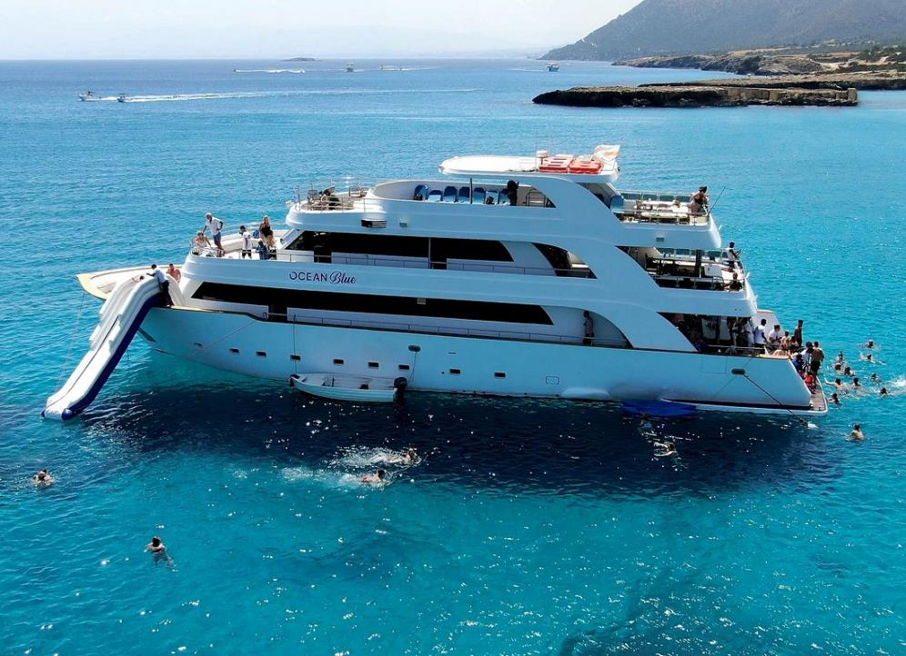
Boat trips in Paphos are a fantastic way to explore the stunning coastline, crystal-clear waters, and nearby hidden gems. Here are some great options for boat trips you can enjoy in the area.
Glass-Bottom Boat Tours
Sailing and Catamaran Cruises
Dolphin and Turtle Watching Cruises
Fishing Trips
Private Boat Charters
Blue Lagoon Cruises
Cruises to the Akamas Peninsula
Snorkeling and Diving Trips

Slide 13
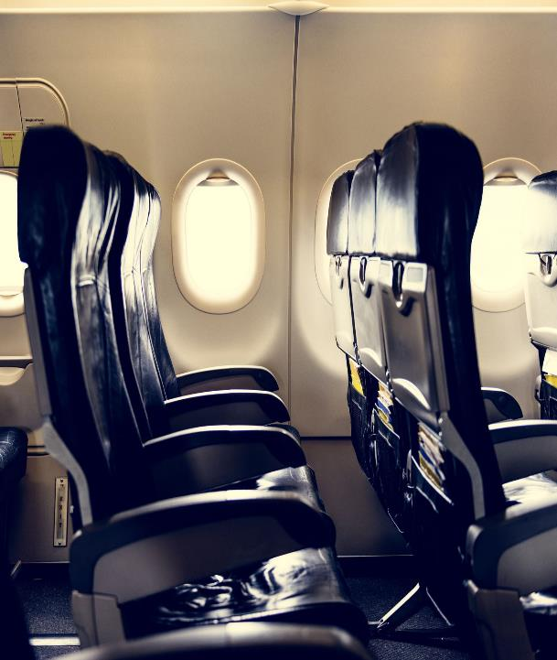
DAY 1
Flight & Airport Transfer:
Start your journey with a premium flight from the UK to Paphos, ensuring maximum comfort for your arrival.
Upon landing, enjoy a private VIP transfer to your chosen resort in a luxury vehicle.
Accommodation:
Check-in at one of the finest 5-star resorts in Paphos: M Boutique Hotel, King Evellthon Beach hotel&resort or Atlantica Golden beach hotel. These beachfront resorts offer a perfect blend of luxury, elegance, and exceptional service.
Evening:
Kick off your stay with a welcome dinner at the resort’s exclusive restaurant, where you’ll indulge in a gourmet meal with stunning views of the Mediterranean.

Slide 14
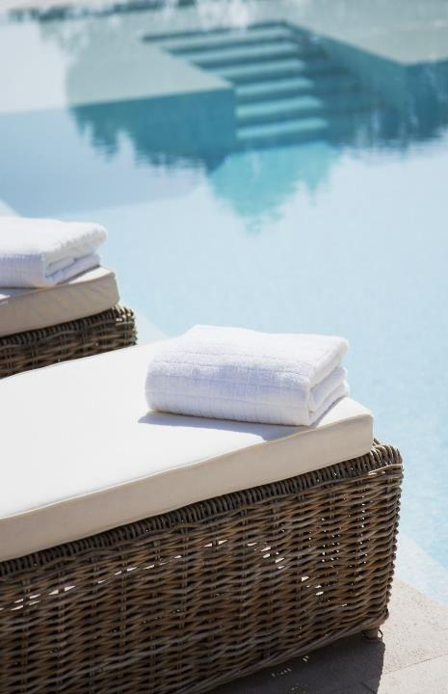
DAY 2-4
Beach Relaxation & Spa Treatments
Morning:
Start each day with a sumptuous breakfast on a beautiful terrace, overlooking the sea.
Relax on the resort’s private beach or by the pool in your personal cabana, enjoying the serenity of the Mediterranean.
Afternoon:
Unwind with luxury spa treatments, including soothing massages, rejuvenating facials, and wellness therapies that will leave you feeling completely refreshed.
Private Yacht Tour:
One afternoon, embark on a private yacht tour. Cruise along the stunning coastline, exploring secluded beaches, swimming in clear turquoise waters, and enjoying champagne and light bites on board.
Evening:
Each night, enjoy exquisite fine dining experiences, featuring fresh Mediterranean seafood, gourmet Cypriot dishes, and expertly crafted cocktails.

Slide 15
DAY 5
Exploring Paphos’ Historic Sites
Morning:
Visit the Tomb of the Kings, an ancient UNESCO World Heritage Site where you’ll explore historical burial chambers carved into the rock. Your personal guide will provide insightful commentary on the site’s significance.
Afternoon:
Discover the treasures of Paphos Archaeological Park, home to some of the best-preserved Roman ruins and stunning mosaics. A private tour will help you fully appreciate the history behind this remarkable site.
Lunch:
Stop for lunch at a local Cypriot taverna, where you can sample Meze—a selection of small dishes that showcase the island’s culinary heritage.
Evening:
Return to your resort for a peaceful evening, perhaps enjoying a sunset cocktail on the beach before a delightful dinner by the sea.

Slide 16
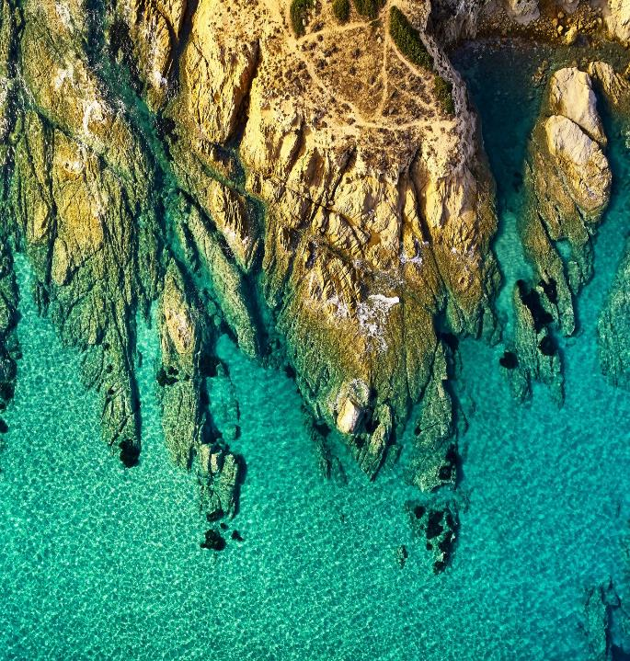
DAY 6
Nature & Adventure
Morning:
Experience the natural beauty of Cyprus with a private jeep safari to Akamas National Park. Here, you’ll embark on an adventure through rugged landscapes, spotting unique wildlife and stopping for scenic views.
Afternoon:
Visit the iconic Blue Lagoon, a natural wonder known for its crystal-clear waters, where you can take a refreshing swim or simply relax by the shoreline.
Evening:
Enjoy a private chef’s dinner back at your resort, where a local chef will prepare a bespoke multi-course meal, showcasing the best of Cyprus’s culinary offerings.

Slide 17
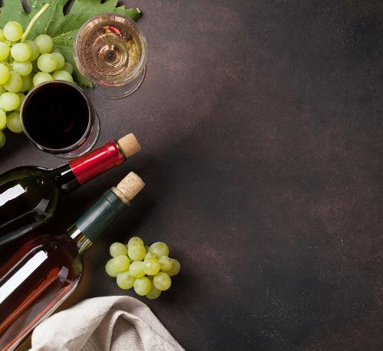
DAY 7
Gastronomy & Wine Tasting
Morning:
Embark on a private wine-tasting tour of the finest local wineries. You’ll be guided through the vineyards, tasting a selection of Cypriot wines, from robust reds to crisp whites.
Afternoon:
Explore a charming traditional Cypriot village, where you’ll have the opportunity to shop for locally made crafts and artisan goods.
Evening:
Enjoy an unforgettable gourmet dinner at the resort’s Michelin-star restaurant or beachside dining venue, where you’ll savor Mediterranean dishes paired with fine wines.

Slide 18
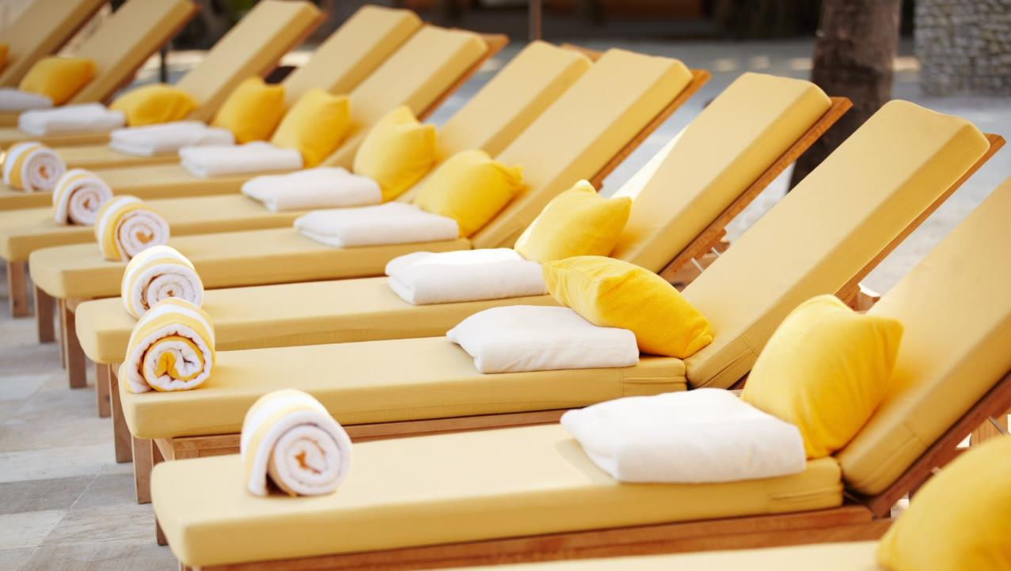
DAY 8
Relax & Depart
Morning:
After a final relaxing breakfast, enjoy some last moments at the resort. Whether it’s a leisurely swim or a final visit to the spa, take the time to unwind.
Transfer to Airport:
Your private transfer will take you back to Paphos International Airport, ensuring a smooth and comfortable departure as you head back home.

Slide 19
WHAT’S INCLUDED IN THE PACKAGE:
Flights: Premium economy or business class flights from the UK to Paphos
Accommodation: 5-star resort stay for 7 nights, with stunning sea views and luxury amenities
VIP Experiences: Private yacht tour, jeep safari, and wine-tasting excursion
Spa & Wellness: Daily spa treatments, including massages and facials
Cultural & Historical Tours: Private guides for visits to the Tomb of the Kings, Paphos Archaeological Park, and local villages
Dining: Gourmet meals, wine pairings, and traditional Cypriot cuisine
Transfers: Private airport transfers and transportation for all excursions

Slide 20
BUDGET BREAKDOWN:
Flights: €500 per person
Accommodation: €1,500 for 7 nights at a luxury 5-star resort
VIP Experiences & Excursions: €500-€1,000
Fine Dining & Drinks: €700-€1,000
Total Estimated Cost: €4,600 - €5,000
This thoughtfully designed package ensures an unforgettable luxury experience, blending relaxation, adventure, culture, and gourmet indulgence. Whether you want to unwind on the beach, explore ancient ruins, or savor exquisite meals, this getaway will leave you with cherished memories and a true taste of Cyprus.

